Slide 1
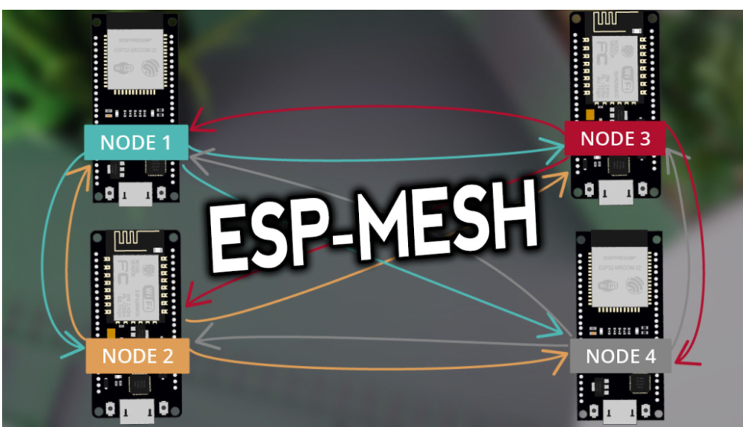
Wireless mesh networking using esp8266
By sankhadip Paul

Slide 2
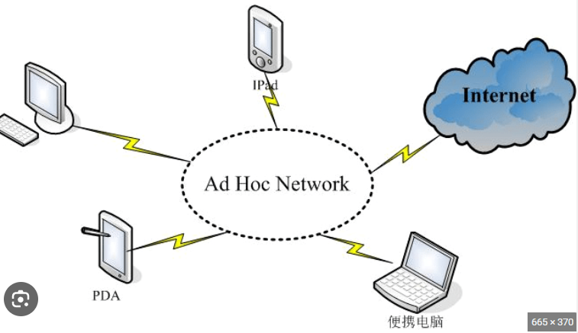
Ad-hoc Network
An ad hoc network is a temporary type of Local Area Network (LAN). If you set up an ad hoc network permanently, it becomes a LAN.
An ad hoc network is one that is spontaneously formed when devices connect and communicate with each other. The term ad hoc is a Latin word that literally means "for this," implying improvised or impromptu.
Ad hoc networks are mostly wireless local area networks (LANs). The devices communicate with each other directly instead of relying on a base station or access points as in wireless LANs for data transfer co-ordination. Each device participates in routing activity, by determining the route using the routing algorithm and forwarding data to other devices via this route.
With an ad hoc network, several devices can share the host device’s internet access. Employers typically pay well for jobs that manage this sort of network, especially in fields that demand a lot of travel.

Slide 3
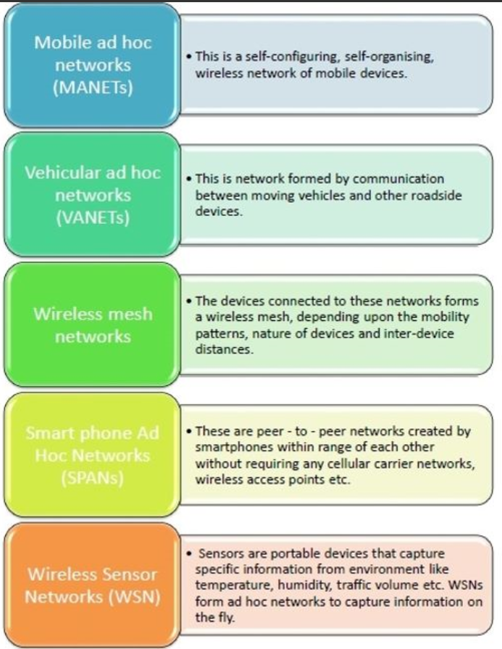
Classification of AD-hoc Networks
Mobile ad hoc networks A mobile ad hoc network (MANET) is a self forming network of mobile devices connected wirelessly.
Wireless mesh networks A wireless mesh network (WMN) is a communications network of radio nodes structured in a mesh topology. The clients within the network are usually laptops, mobile phones, and other wireless equipment. The mesh network, with the help of routers and gateways, transmits data to and from the wireless devices. The communication is within the mesh and not to the internet.
Wireless sensor networks A wireless sensor network (WSN) employs sensor based devices to jointly observe physical or environmental settings such as sound, pressure, climatic changes, and so on. Wireless sensor networks are used in a wide range of areas: traffic control,vehicle detection, greenhouse monitoring and so on

Slide 4
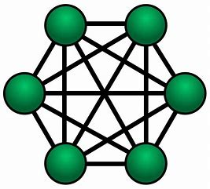
Mesh Network
Mesh networking relies on a set of mesh routers linked together. A mesh router is not a single device like a traditional router; there can be two, three, or even more routers in a mesh system. One of these routers is a gateway that connects to the internet, usually via the DSL or cable modem.
But every mesh router in the system is a node that "talks" to one another and behaves like the primary router, able to communicate with any devices in range. This lets a mesh router system blanket a large home with Wi-Fi without any dead spots.

Slide 5
How mesh has been used in ESP8266
ESP-MESH is a networking protocol built atop the Wi-Fi protocol. ESP-MESH allows numerous devices (referred to as nodes) spread over a large physical area (both indoors and outdoors) to be interconnected under a single WLAN (Wireless Local-Area Network).
ESP-MESH is self-organizing and self-healing meaning the network can be built and maintained autonomously.
With ESP-MESH, the nodes don’t need to connect to a central node. Nodes are responsible for relaying each others transmissions. This allows multiple devices to spread over a large physical area. The Nodes can self-organize and dynamically talk to each other to ensure that the packet reaches its final node destination. If any node is removed from the network, it is able to self-organize to make sure that the packets reach their destination.

Slide 6
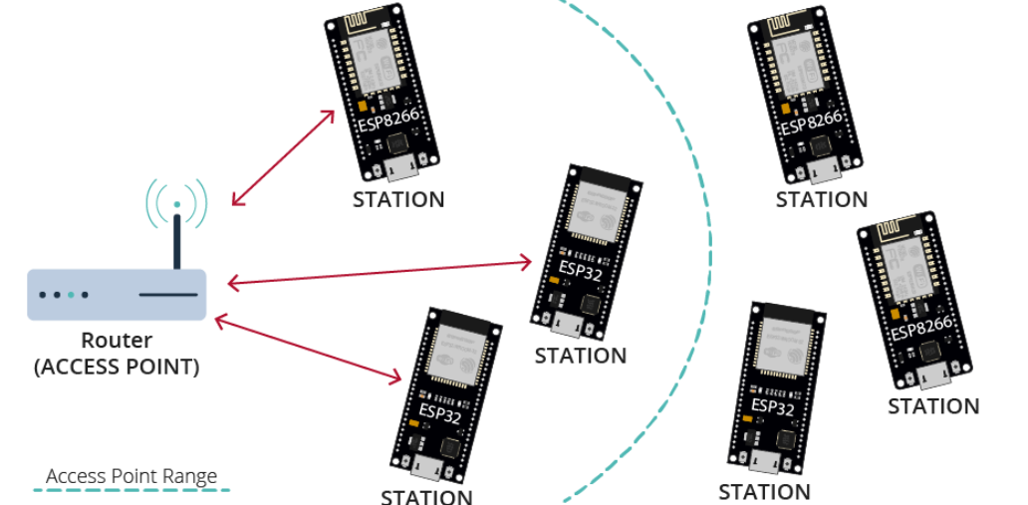
Traditional WIFI network Architecture
In a traditional Wi-Fi network architecture, a single node (access point – usually the router) is connected to all other nodes (stations). Each node can communicate with each other using the access point. However, this is limited to the access point wi-fi coverage. Every station must be in the range to connect directly to the access point. This doesn’t happen with ESP-MESH.

Slide 7
Painless mesh library
The painlessMesh library allows us to create a mesh network with the ESP8266 or/and ESP32 boards in an easy way.
“painlessMesh is a true ad-hoc network, meaning that no-planning, central controller, or router is required. Any system of 1 or more nodes will self-organize into fully functional mesh. The maximum size of the mesh is limited (we think) by the amount of memory in the heap that can be allocated to the sub-connections buffer and so should be really quite high.”

Slide 8
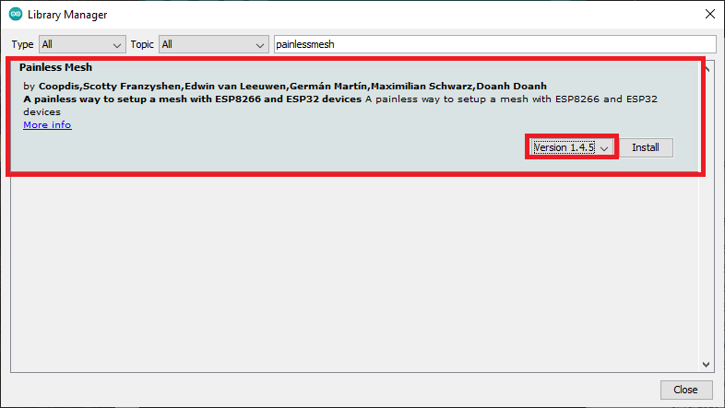
How to install painless mesh library
You can install painlessMesh through the Arduino Library manager. Go to Tools > Manage Libraries. The Library Manager should open.
Search for “painlessmesh” and install the library. We’re using Version 1.4.5

Slide 9
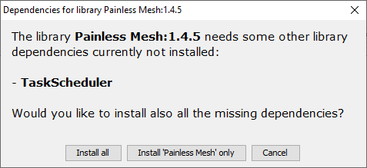
How to install painless mesh library
This library needs some other library dependencies. A new window should pop up asking you to install any missing dependencies. Select “Install all”.

Slide 10

ESP-MESH(Broadcast messages)
To get started
Esp8266
We’ve experimented with four boards (Four ESP8266). You can add or remove boards. The code is compatible with all the boards.
Our experiment creates a mesh network in which all boards broadcast messages to all the other boards.

Slide 11
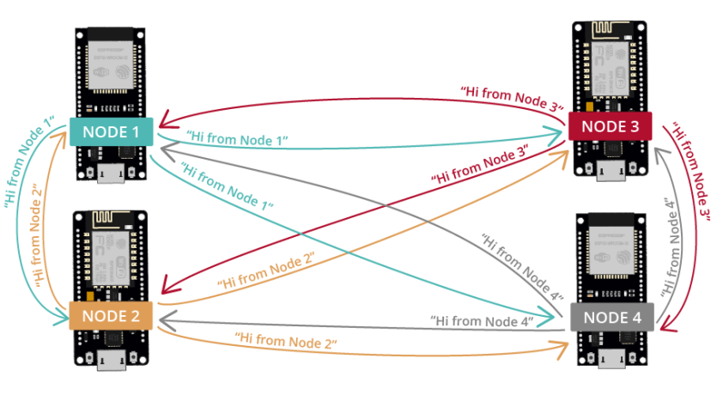
ESP-MESH(Broadcast messages)

Slide 12
Code and outputs
#include "painlessMesh.h"
#define MESH_PREFIX "whateverYouLike"
#define MESH_PASSWORD "somethingSneaky"
#define MESH_PORT 5555
Scheduler userScheduler; // to control your personal task
painlessMesh mesh;
// User stub
void sendMessage() ; // Prototype so PlatformIO doesn't complain
Task taskSendMessage( TASK_SECOND * 1 , TASK_FOREVER, &sendMessage );

Slide 13
Code and outputs
void sendMessage() {
String msg = "Hello from node … ";
msg += mesh.getNodeId();
mesh.sendBroadcast( msg );
taskSendMessage.setInterval( random( TASK_SECOND * 1, TASK_SECOND * 5 ));
}
// Needed for painless library
void receivedCallback( uint32_t from, String &msg ) {
Serial.printf("startHere: Received from %u msg=%s\n", from, msg.c_str());
}
void newConnectionCallback(uint32_t nodeId) {
Serial.printf("--> startHere: New Connection, nodeId = %u\n", nodeId);
}

Slide 14
Code and outputs
void changedConnectionCallback() {
Serial.printf("Changed connections\n");
}
void nodeTimeAdjustedCallback(int32_t offset) {
Serial.printf("Adjusted time %u. Offset = %d\n", mesh.getNodeTime(),offset);
}
void setup() {
Serial.begin(115200);
//mesh.setDebugMsgTypes( ERROR | MESH_STATUS | CONNECTION | SYNC | COMMUNICATION | GENERAL | MSG_TYPES | REMOTE ); // all types on
mesh.setDebugMsgTypes( ERROR | STARTUP ); // set before init() so that you can see startup messages

Slide 15
Code and outputs
mesh.init( MESH_PREFIX, MESH_PASSWORD, &userScheduler, MESH_PORT );
mesh.onReceive(&receivedCallback);
mesh.onNewConnection(&newConnectionCallback);
mesh.onChangedConnections(&changedConnectionCallback);
mesh.onNodeTimeAdjusted(&nodeTimeAdjustedCallback);
userScheduler.addTask( taskSendMessage );
taskSendMessage.enable();
}
void loop() {
// it will run the user scheduler as well
mesh.update();
}

Slide 16
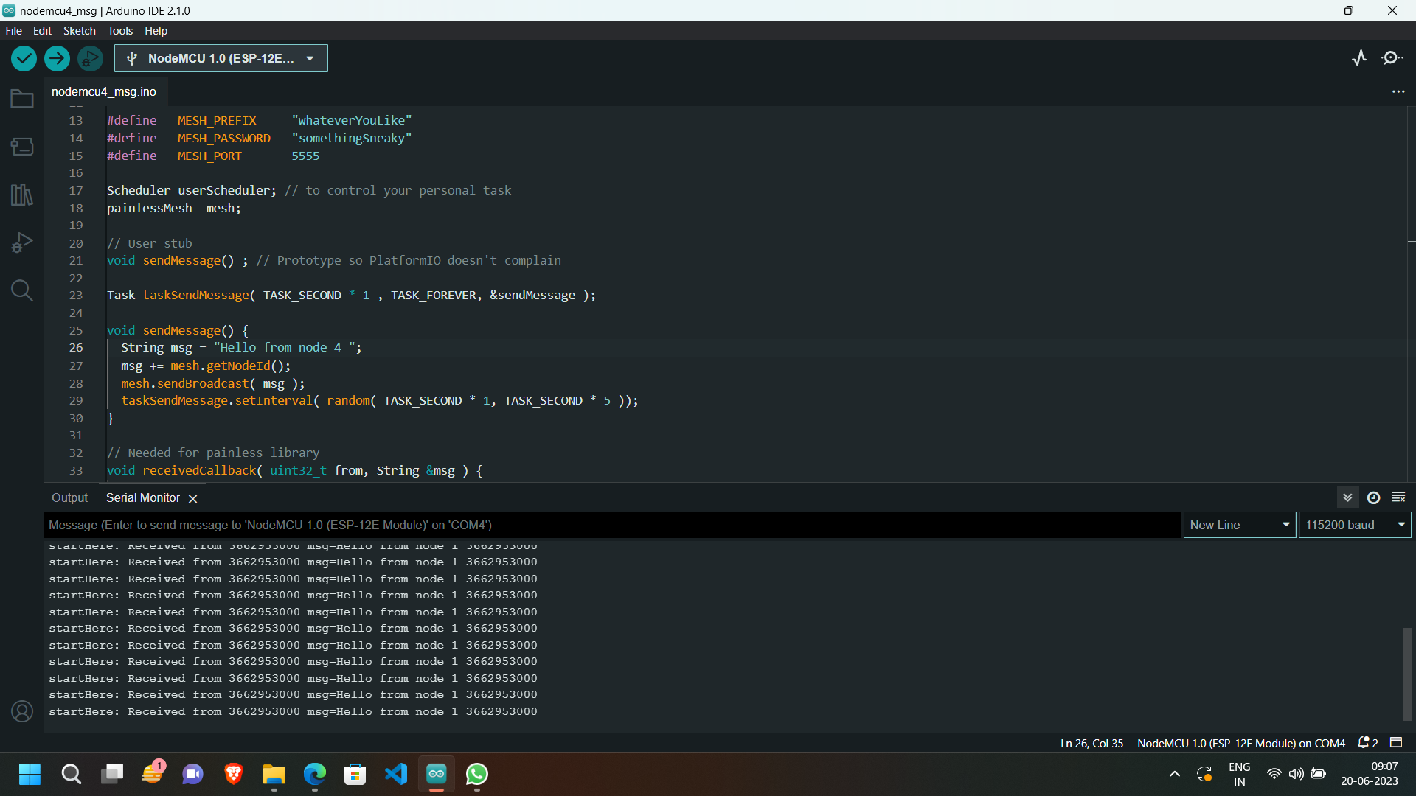
Code and outputs

Slide 17
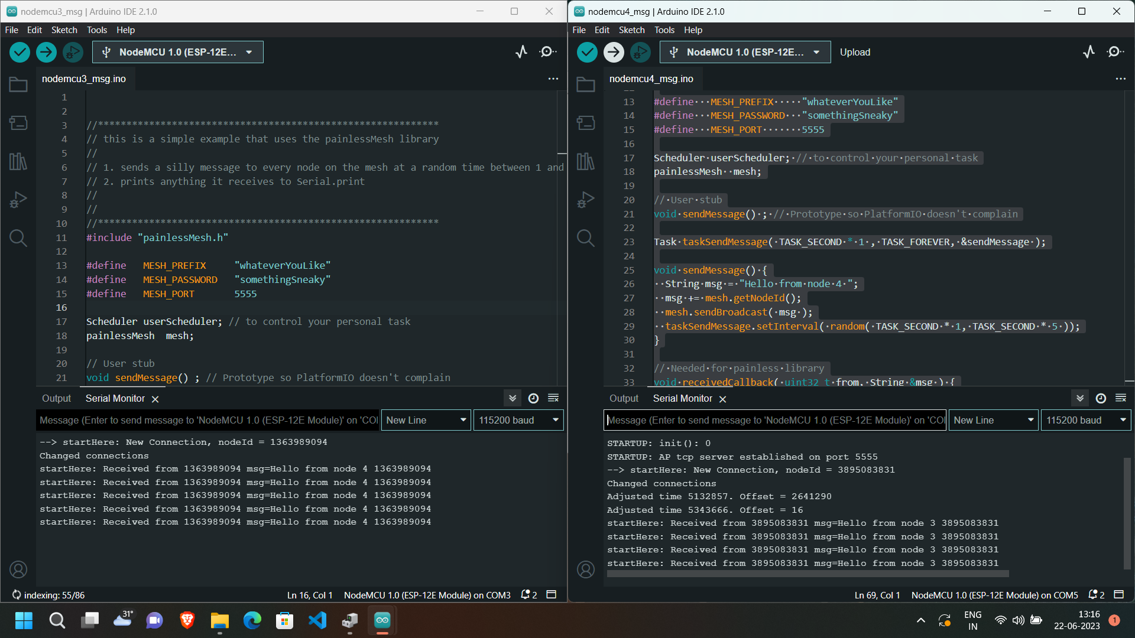
Code and outputs

Slide 18
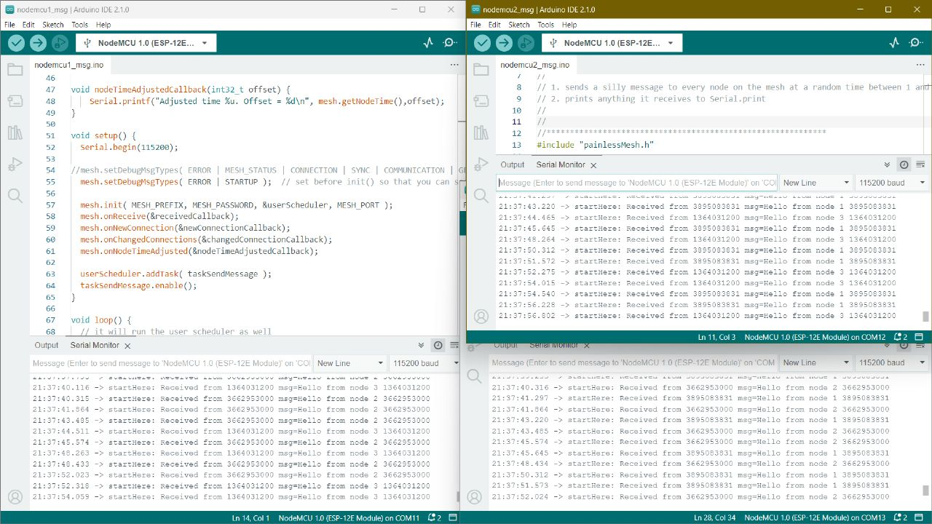
Code and outputs

Slide 19
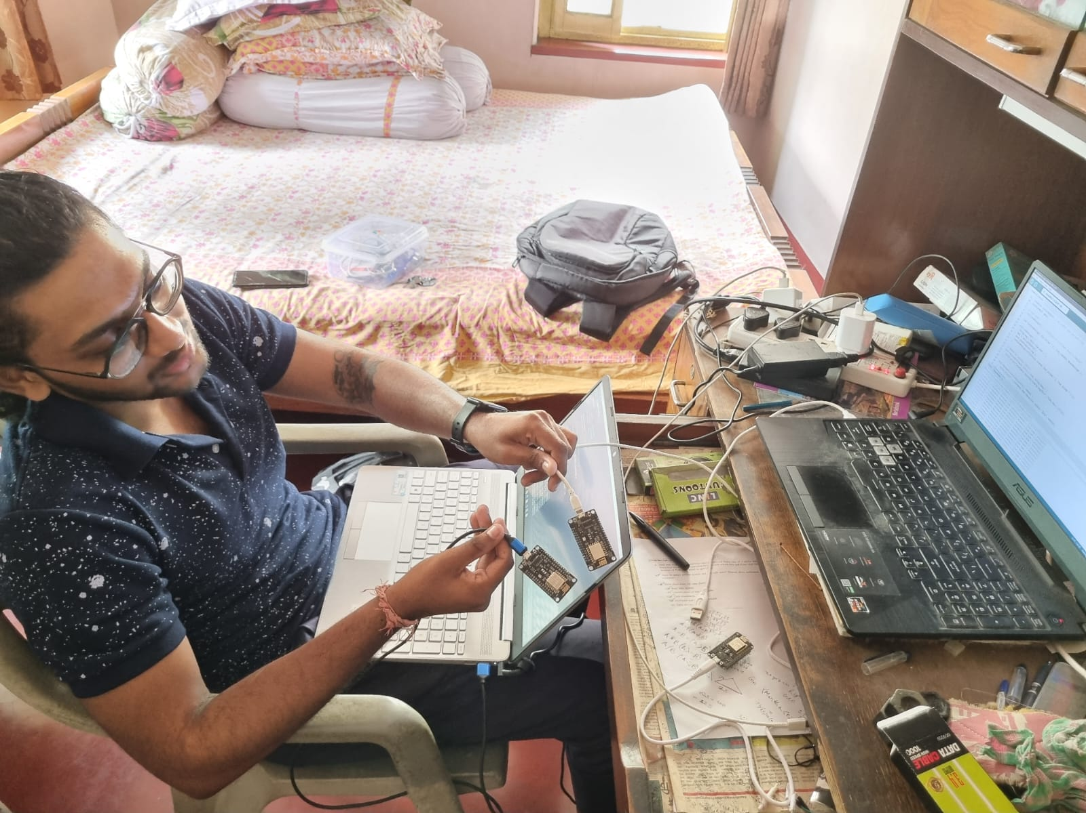
Code and outputs

Slide 20

Thank you

